Slide 1
New Technology File System(NTFS)
See FileSystem_intro.pdf

Slide 2
Overview
FAT vs NTFS
NTFS Architecture
Booting Process
Master Boot Record
Boot Sector
Master File Table
MFT Records

Slide 3
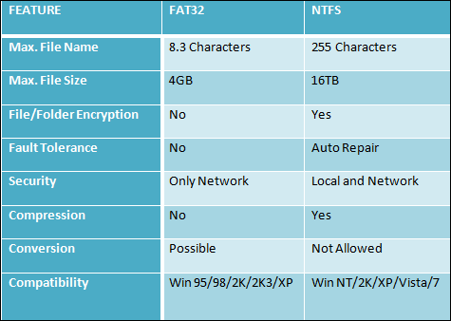
FAT Vs. NTFS
FAT stands for File Allocation Table
FAT32: table entry 32 bits
an older type
NTFS stands for New Technology File System

Slide 4
NTFS
Default file system for Windows NT, 2000, XP, and Windows Server 2003
www.ntfs.com

Slide 5
Microsoft NTFS Goal
Provide a reliable, secure, scalable, and efficient file system
NTFS features
Logging
File/folder permissions
Compression
Encryption

Slide 6
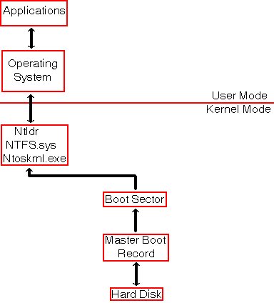
NTFS Architecture for x86-based Systems
Figure shows how an application communicates with a disk.
All file systems operations are done in kernel mode by the system file drivers for NTFS.
These use the MBR and the boot sector in order to find their way on the disk.
Note: different name, same thing
Volume boot record
/partition boot sector
/boot sector

Slide 7
Booting Process
To boot up an x86-based computer, two sectors on the disk are critical:
The Master Boot Record (MBR), which is located at sector 0 of cylinder 0, head 0, the first physical sector of a hard disk and is not part of any partition.
The Boot sector, which is located at sector 0 of each partition
These sectors contain both executable code and the data required to run the code.

Slide 8
Master Boot Record
MBR describes the partitions on the disk
VBR/boot sector describes that particular partition
All Windows OS require the disk to have at least one primary partition.
MBR created when the disk is partitioned
contains a small amount of executable code called the master boot code
At the end of the MBR is a 2-byte structure called a signature word or end of sector marker
is always set to 55 AA.
The master boot code
Finds the starting sector of the active partition
Loads a copy of the Boot sector from the active partition into memory
Transfers control to the executable code in the VBR

Slide 9
BIOS->MBR->Boot Sector->bootstrap->OS loader
Boot Sector: Sector zero in the active partition
Boot sector followed by the boostrap code occupy the first 16 sectors of the partition
boostrap =BOOTMGR Loader
only about half of that area has actually been used for code and data,
the remaining bytes always being zero-filled.
http://thestarman.pcministry.com/asm/mbr/BOOTMGR_Loader_Sectors.htm
The operating system loader occupy subsequent sectors.
OS loader: NTLDR up to and including Windows XP, winload.exe and the Windows Boot Manager in Vista onwards

Slide 10
Master Boot Record
When a pc is booted up there is a defined process to go through to present a usable system.
In a rather extreme simplification, on a powerup up or reset the CPU's registers will be initialized with default values and the Extended Instruction Pointer (EIP), which holds the address of the instruction being executed by the cpu, will be set. This initial instruction is a jump to the BIOS entry point. The BIOS code runs a power-on self test (POST) and then locates the Master Boot Record at sector 0 on the disk.
The BIOS loads the MBR into RAM and transfers execution to the MBR boot code, which in turn checks the partition table within the MBR for an active partition. The MBR code loads the boot sector code from the selected partition, which in turn loads the operating system kernel, completing the startup procedure.

Slide 11
After booting
Now the PC has been booted into an NTFS partition.
In NTFS
everything is a file
the description of every file (record) is held in MFT
MFT components
Record
describe every file/ directory
1024-byte
System or metadata records
describe MFT itself
16 records
with names beginning with $ and a capital letter.
Other MFT attributes
forever expanding
with a default size of 12.5% of the partition
No MFT record is ever removed from the MFT, they are reused.
When a file or directory is deleted its record is flagged as deleted and is then available for re-use in future file or directory allocations.

Slide 12
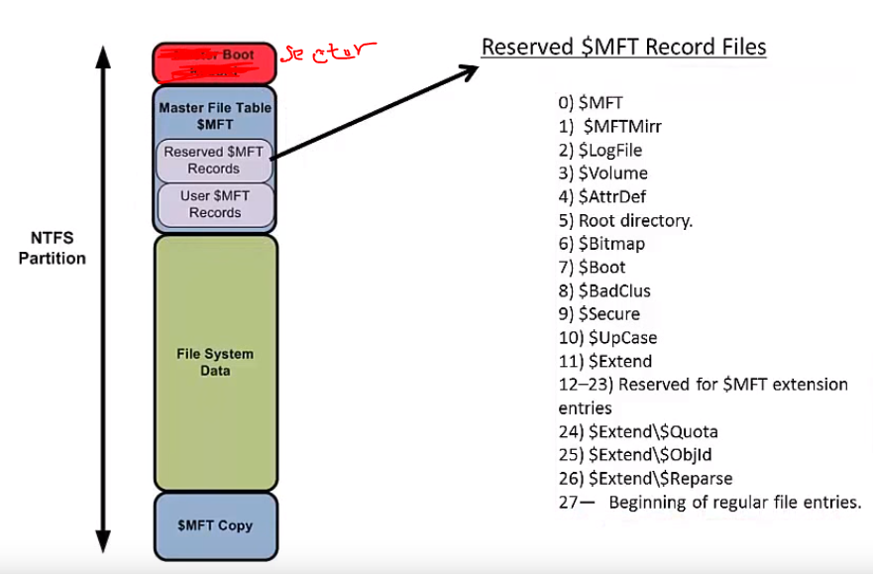
https://www.youtube.com/watch?v=xW5UwDztkX4

Slide 13
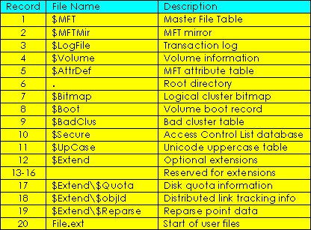
System file records in the MFT

Slide 14
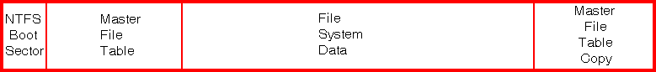
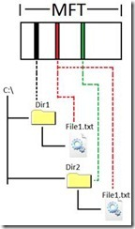
Another view of Structure of NTFS
Boot Sector (VBR)
Contain the starting address of MFT
Master File Table
is a database for every file and directory
Contains all file information,
Created, deleted, updated
File System Data

Slide 15
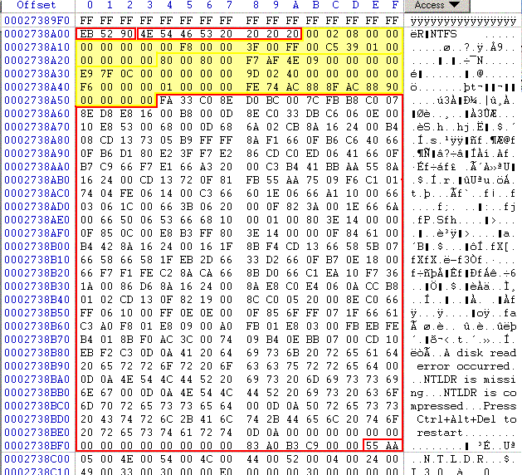
NTFS boot sector layout.
Offset | Length of Field | Meaning
0x00 | 3B | Jump Instruction
0x03 | 8B | OEM ID
0x0B | 25B | BPB
0x24 | 48B | Extended BPB
0x54 | 426B | Bootstrap Code.
0x1 FE | 2B | End of Sector Marker
BPB: BIOS parameter block:
--describe the physical information/layout of a data storage

Slide 16
NTFS boot sector layout-BPB
Offset | Length of Field | Typical Value | Meaning
0x0B | 2B | 00 02 | Bytes per sector. Typical value is 512B per sector
0x0D | 1B | 08. | Sectors per Cluster
0x15 | 1B | F8 | Media descriptor. F8: hard disk; F0: high density floppy.
0x28 | 8B | xx xx xx xx xx xx xx xx | Total sectors.
0x30 | 8B | xx xx xx xx xx xx xx xx | Start Logical cluster number for the Master File Table (File $MFT)
0x38 | 8B | xx xx xx xx xx xx xx xx | Start Logical cluster number for the copy of the Master File Table (File $MFTmir)
0x40 | 1B | F6 | Clusters per MFT Record
0x48 | 8B | xx xx xx xx xx xx xx xx | Volume serial number.

Slide 17
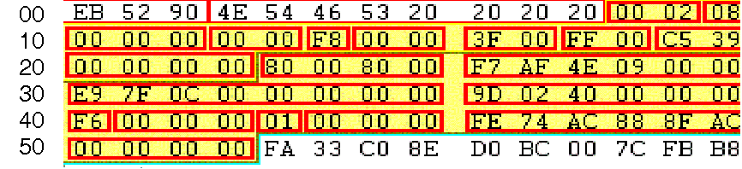
NTFS BPB
0x0B Bytes per sector: 00 02 → 0200 = 512 decimal
0x0D Sectors per cluster: 0x 08
0x0E Reserved sectors 0x 00 00

Slide 18
NTFS BPB
0x15: Media Descriptor: F8 is hard drive, F0 is floppy.
0x28 Total number of sectors: F7AF4E0900000000 → 000000094EAFF7 → 156,151,799 sectors, i.e. ~80GB

Slide 19
NTFS BPB
0x30: Starting logical cluster number for MFT copy 1: cluster C07FE9 (File $MFT)
0x38: Starting logical cluster number for MFT copy 2: cluster 40029D

Slide 20
NTFS BPB
The clusters per MFT record : is either a masterpiece of ingenuity or a ridiculous flourish of complexity
If this value is positive then the MFT record size
is a multiple of the cluster size.
If the value is negative however, as it most likely will be,
then it is resolved by raising 2 to the power of the absolute value of this entry. 2^(-1 * Clusters per MFT)
The value is 0xF6, which is -10, so the MFT record size is 2 to the power of 10, which is 1024.
0x40: Clusters per MFT record: F6
0x48: Volume Serial Number

Slide 21
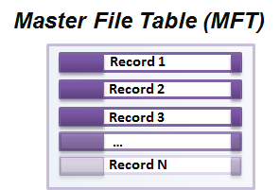
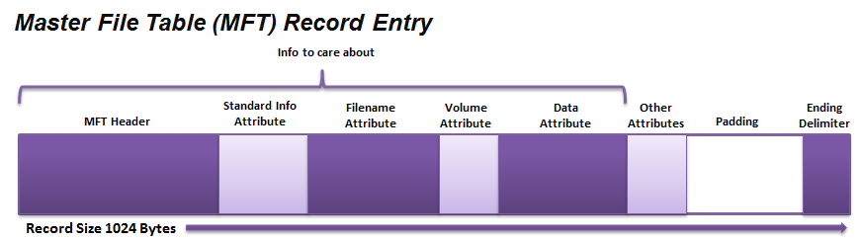
Master File Table (MFT)

Slide 22
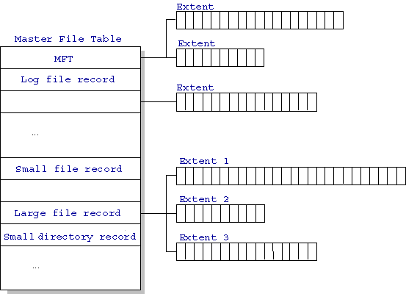
Master File Table (MFT)

Slide 23
MFT Record Structure
Entries are 1KB each
Entries contain
MFT Header
File Attributes
Data Attributes

Slide 24
MFT Record
Small Files (<900B) are contained completely in the MFT entry.
Larger ones are organized as a B-tree and have pointers to external clusters

Slide 25
MFT Record
Record reference address (64bits)= record number (48bit) + sequence number (16bits)
record number
starting with the first record (index 0)
describing in the $MFT file itself
sequence number
incremented whenever the file represented

Slide 26
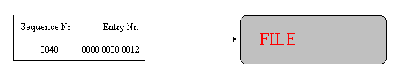
MFT Record
NTFS uses the record reference address to refer to MTF entries.
When the system crashes during allocation, then the sequence number describes whether the MTF entry belonged to the previous file or to the current one.
If the file is deleted
the MFT entry reused for another file
then the sequence number would become 0041
the new file reference address 0041000000000012.

Slide 27
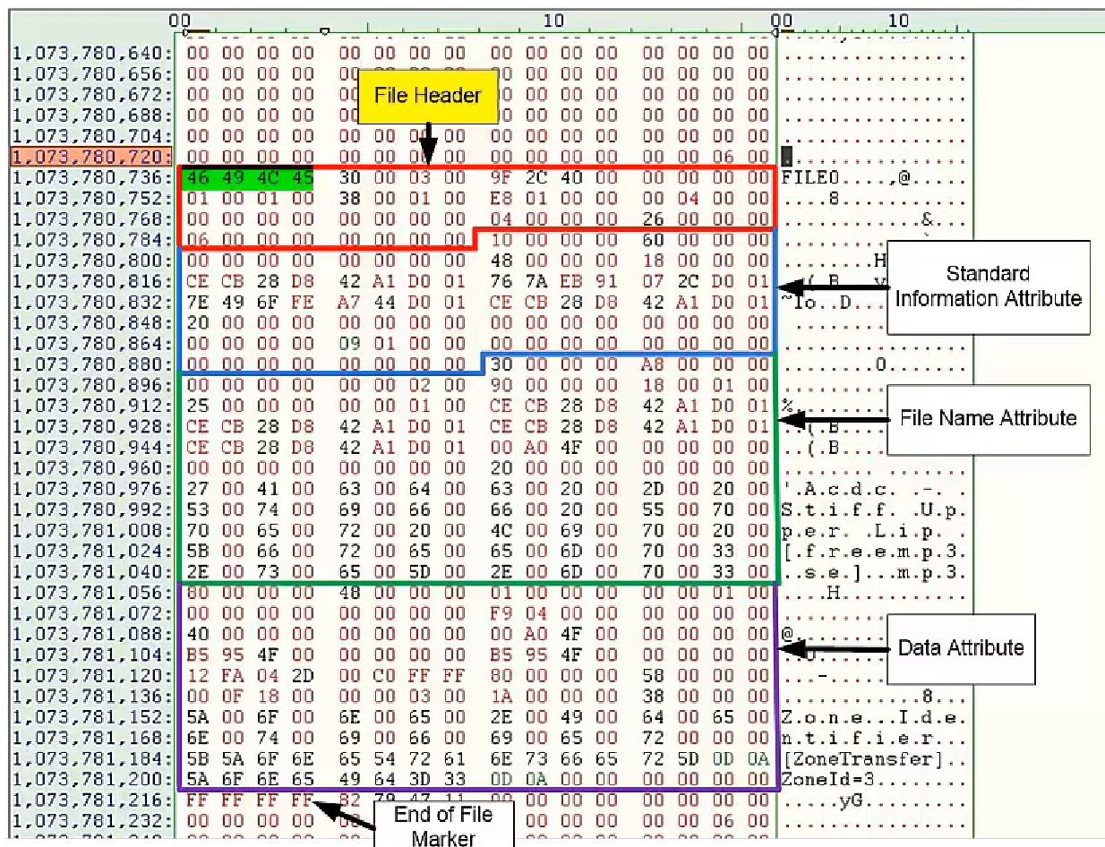
MFT Recode Example

Slide 28
Question: How did you determine the size of each attribute
Find the start position of the first attribute in the entry head
Offset 0x14, 2-byte
The attribute head contains the size of the attribute
The next offset is the start of the next attribute

Slide 29
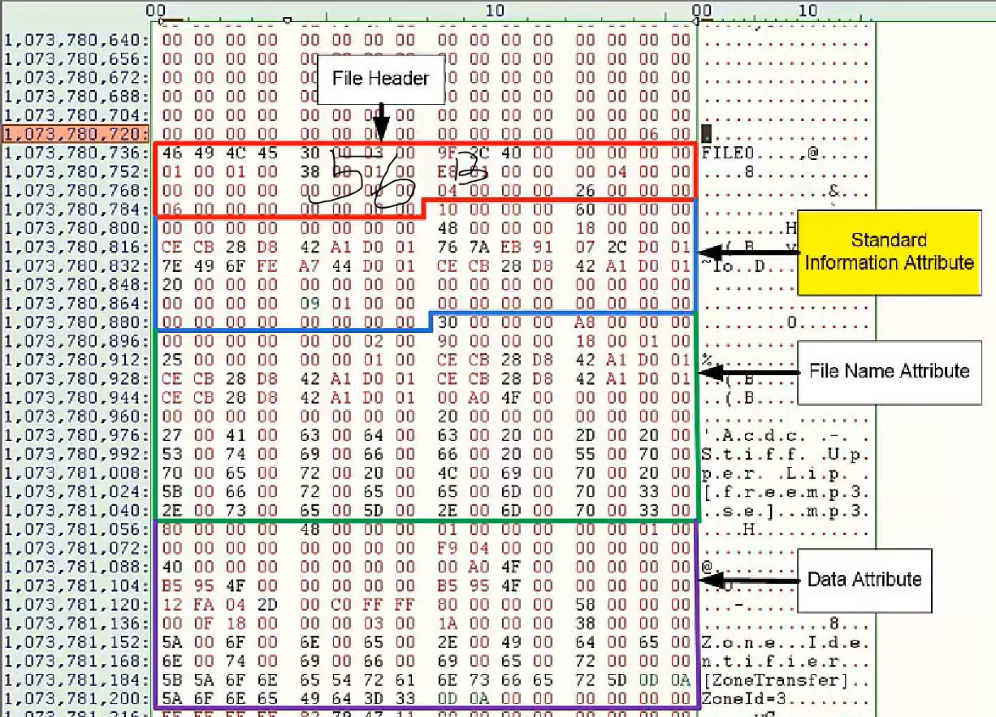
MFT Entry Header
Tell you the information of the record entry itself.
This information will help you find the offsets to the meat of the information you need.
Use this information to recreate the file structure hierarchy.
The typical length of the header is 56 Bytes.
48-byte header
8-byte fixup array
What is fixup array?
The smallest unit of disk space that NTFS uses is a Cluster. This can vary from one sector to 128 sectors, the usual number is 8 (4KB). Naturally this is dependent on the sector and Cluster. sizes declared in$Boot.
Because a single sector could fail, it's important for NTFS to be able to detect errors in a cluster. For this purpose the sectors have Fixups, which are kept in an Update Sequence Array.

Slide 30
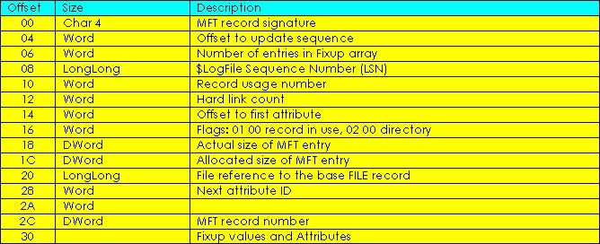
MFT Entry Header
0x10, $Standard_Information

Slide 31
Length of Attribute is at offset 0x04, 4-byte
Size of each attribute:
0x60=96 bytes
0xa8=138 bytes
0x48=72 bytes
0x58=88 bytes

Slide 32
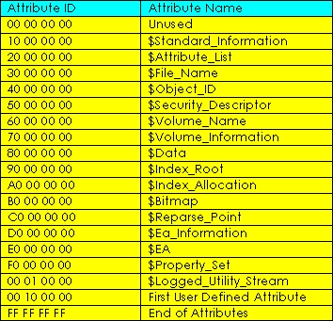
Attribute ID: 10, 30, 80

Slide 33
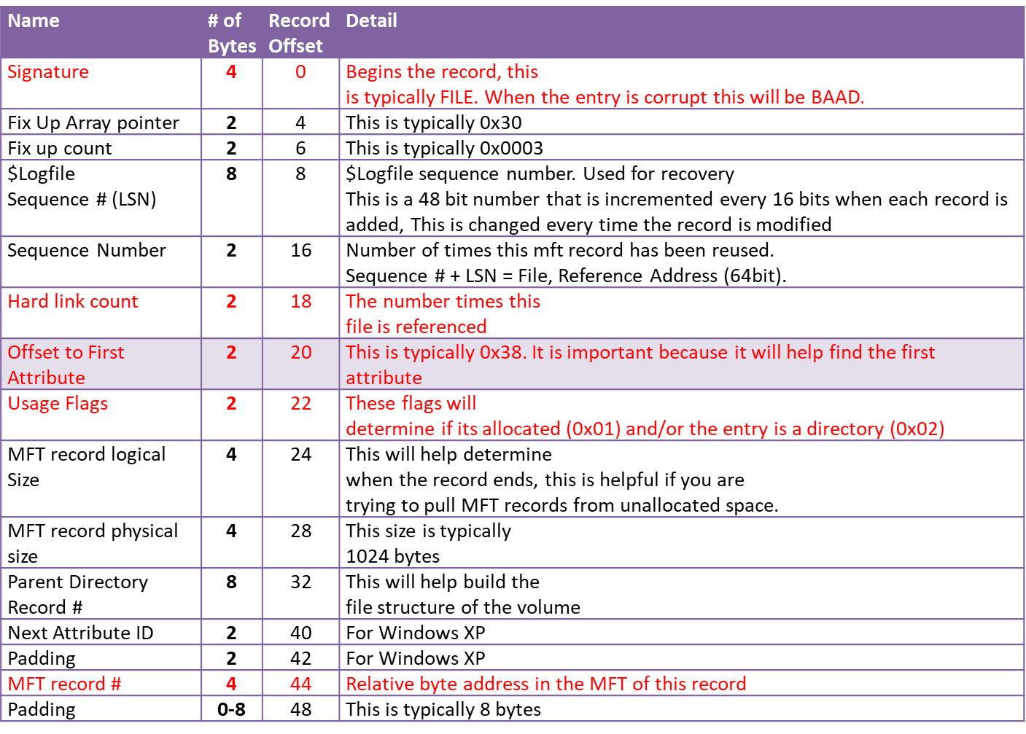
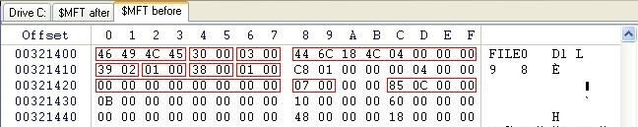
More on MFT Record header
0x20 - if this MFT record is the base entry for the file then this field is zero: if the record is an extension then this field holds the base record reference address
0x2C - The relative cluster number of this MFT record starting from zero. If this value - 0xC85 - is multiplied by 0x400 (the cluster size) we get 0x321400, the relative byte address in the MFT of this record.

Slide 34
Name | # of Bytes | Record Offset | Detail
Signature | 4 | 0 | Begins the record, this is typically FILE. When the entry is corrupt this will be BAAD.
Fix Up Array pointer | 2 | 4 | This is typically 0x30
Fix up count | 2 | 6 | This is typically 0x0003
$Logfile Sequence # (LSN) | 8 | 8 | $Logfile sequence number. Used for recovery This is a 48 bit number that is incremented every 16 bits when each record is added, This is changed every time the record is modified
Sequence Number | 2 | 16 | Number of times this mft record has been reused. Sequence # + LSN = File, Reference Address (64bit).
Hard link count | 2 | 18 | The number times this file is referenced
Offset to First Attribute | 2 | 20 | This is typically 0x38. It is important because it will help find the first attribute
Usage Flags | 2 | 22 | These flags will determine if its allocated (0x01) and/or the entry is a directory (0x02)
MFT record logical Size | 4 | 24 | This will help determine when the record ends, this is helpful if you are trying to pull MFT records from unallocated space.
MFT record physical size | 4 | 28 | This size is typically 1024 bytes
Parent Directory Record # | 8 | 32 | This will help build the file structure of the volume
Next Attribute ID | 2 | 40 | For Windows XP
Padding | 2 | 42 | For Windows XP
MFT record # | 4 | 44 | Relative byte address in the MFT of this record
Padding | 0-8 | 48 | This is typically 8 bytes

Slide 35
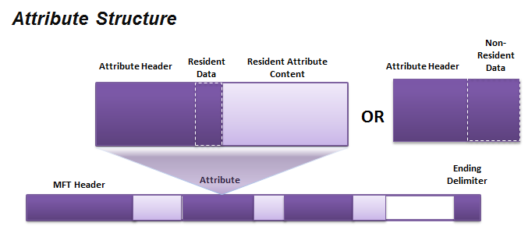
MFT Attributes
The attribute header gives basic information about the attribute.
A resident attribute is stored in the MFT entry.
A non-resident entry is stored in a cluster outside the MFT.

Slide 36
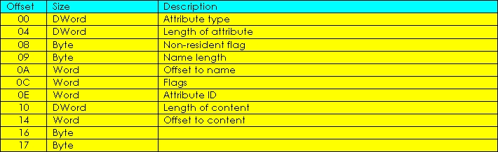
Attribute Header - Resident

Slide 37
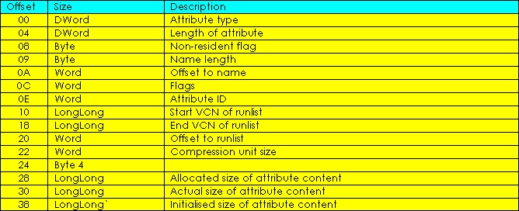
Attribute Header - Non-Resident

Slide 38
Attribute Header- Resident vs. Non-Resident
First 16 B is the same.
because non-resident attributes need to describe an arbitrary number of cluster runs, consecutive clusters that they occupy.
Length of resident
24
Length of non-resident
64

Slide 39
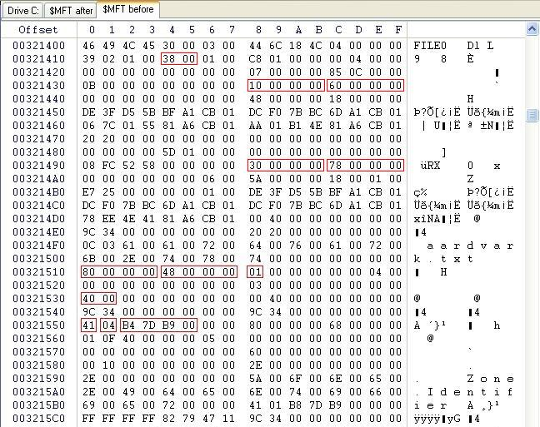
Another Example: Aardvark.txt file record
the offset to the first attribute in the record is 0x38
At 0x38 is 0x10, $Standard_Information
at offset 0x04 in the attribute is the length of this attribute, 0x60, lead to
attribute 0x30, $File_Name, length 0x78, which leads to
attribute 0x80, $Data, length 0x48, which leads to
attribute 0xFFFFFFFF, the end of attributes

Slide 40
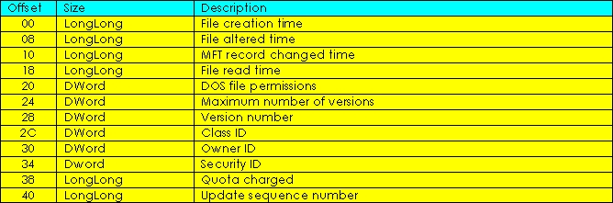
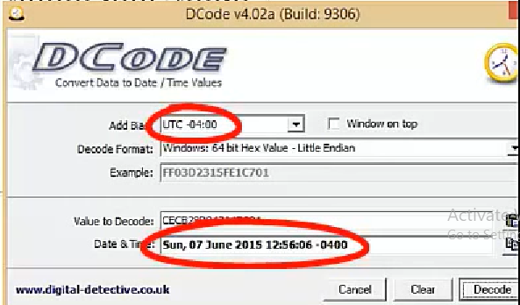
$Standard_Information attribute
Note: the length of a attribute header is 24Bytes
hex

Slide 41
$File_Name attribute
File name in UTF-16 unicode.
It contains
the allocated size: a multiple of the cluster size
the real size: the actual size of the file.
The allocated and real sizes are also held in MFT directory records,
these are the values displayed in Explorer folder listings.

Slide 42
$File_Name attribute
Unicode: two bytes
Again Note: the length of a attribute header is 24B/the length of att is 0xA8
Offset | Size | Description
~ | ~ | Standard Attribute Header (24 bytes)
0x00 | 8 | File reference to the parent directory.
0x08 | 8 | C Time - File Creation
0x10 | 8 | A Time - File Altered
0x18 | 8 | M Time - MFT Changed
0x20 | 8 | R Time - File Read
0x28 | 8 | Allocated size of the file
0x30 | 8 | Real size of the file
0x38 | 4 | Flags, e.g. Directory, compressed, hidden
0x3c | 4 | Used by EAs and Reparse
0x40 | 1 | Filename length in characters (L)
0x41 | 1 | Filename namespace
0x42 | 2L | File name in Unicode (not null terminated)
http://inform.pucp.edu.pe/~inf232/Ntfs/ntfs_doc_v0.5/attributes/file_name.html

Slide 43
$Data attribute
has no specific layout
if the attribute is resident it will contain the file's data in its entirety,
if that data is small enough to fit within the MFT record, or
if non-resident it will hold one or more cluster start and length fields.

Slide 44
$Data attribute Example: Aardvark.txt file record
attribute 0x80, $Data, length 0x48
At offset 0x20, the offset to the runlist is 0x40, leads to the first datarun 0x41

Slide 45
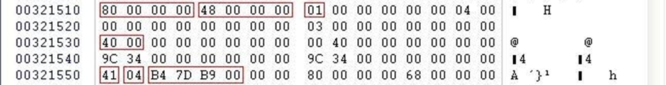
What is Datarun
A datarun has three components
a length/offset byte (2 Bytes) 0x41
length of the cluster run number (1 Bytes) 0x1
the length of the cluster start number (1 Bytes) 0x4
a cluster run size 0x1 byte
a cluster start number (offset to previous datarun) 0x4 byte
file data is at
logical cluster number (LCN) 0x00B97DB4
Advancing to the next datarun gives a byte of 00
which indicates the end of the runlist.
Aardvark has only one data extent on disk.

Slide 46
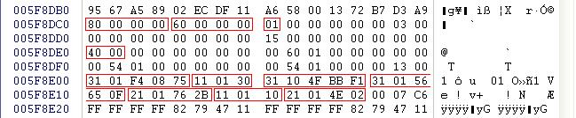
Datalist with many dataruns
Datarun list (start offset 40)
0x31,01,F40875
0x11,01,30 (0x7508F4+0x30=0x750924)
0x31,10,4FBBF1
0x31,01,56650F
0x21,01,762B
0x11,01,10
0x21,01,4E01
0x00 (end)
Datarun LCN's are always relative to the cumulative LCN of all previous dataruns.
Set highlighted datarun
The third datarun has 0x10 clusters, but starts at 0xF1BB4F. (32 bits, left most=1)
This is a negative number. Its negative value is 0xE44B1, -935089.
This number is subtracted from the cumulative LCN, giving us an LCN of 0x66C473, 6734963.

Slide 47
Bitmaps
System bitmaps $Bitmap
this holds the map of logical clusters in(not)use
for finding free space when a file is allocated.
MFT record attribute $Bitmap (an attribute ID of 0xB0)
used for mapping MFT records in - and out - of use.
used in directory and INDX records in the MFT.
bit set to 1 = an in-use cluster or record
bits in each bitmap byte do not read sequentially
read from the low-order bit first.
E.g., FF 13 translates as bit pattern 1111 1111 0001 0011, but represents 1111 1111 1100 1000
clusters one to ten and thirteen in use, clusters eleven and twelve and fourteen onwards available for use.

Slide 48
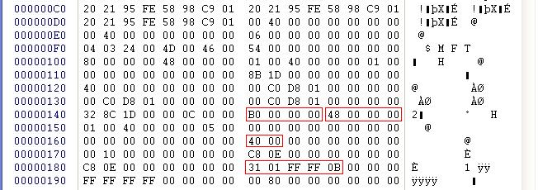
Example: Bitmaps
0xB0: bitmap ID
0x40: offset of MFT bitmap
31: 1 sector, start cluster is 3 bytes long (see datarun)
The MFT bitmap is one cluster at LCN 0xBFFFF

Slide 49
File deletion Overview
What happens when a file is deleted?
This is of interest if you're trying to recover a deleted file, or trying to understand why you can't recover a particular deleted file.
Two scenarios
Move to Recycler
Deletion

Slide 50
The Recycler
When files and folders are sent to the Recycler
they remain as live files,
taking up allocated space and being protected from being overwritten.
file data is untouched but the file and folder names are amended.
In Windows XP
relocated to a protected system directory named \Recycler\SID where SID is the SID of the user that performed the deletion.
The files are renamed to D followed by the drive letter followed by an sequential index number, followed by the original file extension,
e.g. Dc145.doc.
There is also a file named INFO2
contains entries, identified by the index numbers,
describe the original file and folder sizes and path/names, etc of all the files in the recycler.

Slide 51
The Recycler: In Vista, Windows 7 and Windows 8
The Recycler is in a protected system directory named \$Recycle.Bin\SID
SID is the SID of the user that performed the deletion.
A file is renamed to $R followed by a set of random characters, followed by the original file extension,
e.g. $Rhdxenv.doc.
A matching file is created as $I followed by the same random characters and extension as the $R file.
This file contains the original filename/path and file size, and the date and time that the file was moved to the Recycle Bin (there is no INFO2 file).
The $I files are all 544 bytes long.

Slide 52
File is Physically Deleted
NTFS will modify its system files to reflect the deletion.
The file's data, the clusters allocated to the file, are not modified or even accessed
it is this that enables file recovery to be attempted
On file deletion NTFS will:
Update all the file's MFT records to deleted state
Remove the entry for the file from the owning folder's MFT record
Update the MFT's bitmap to set the file's records as free for reuse
Update the cluster bitmap ($Bitmap) to set the file's clusters as free for reuse
The pertinent MFT records aren't removed when a file is deleted, due to the use of absolute record numbers to relate records to indexes, and to themselves, etc.

Slide 53
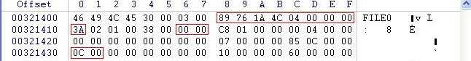
Aardvark's MFT record after deletion
0x08 - the logfile sequence number has changed
0x10 - the record usage count increases by one
0x16 - the flags field changes to 0x0000
0x30 - the fixup array value increases by one
In-use flags,
set to 0x0000 (or 0x0002 for a folder).
The logfile sequence number reflects the entry in the logfile for this deletion (to ensure completion of the task or backout in case of error),
the increase in the record usage count is to ensure that this record no longer matches any record/seqno combination.
The fixup array change is normal sector write validation.
The bit in the MFT bitmap for this record will be set to zero
as will be the bits in the $Bitmap file that represent the file's data clusters.
The MFT directory record for the file's parent folder will be updated
the file entry removed
the following entries moved up to take its place.

Slide 54
Note: what is fixup array
A single sector could fail, it's important for NTFS to be able to detect errors in a cluster. For this purpose the sectors have “Fixups”, which are kept in an “Update Sequence Array”.
Many important Metadata Records use fixups to protect data integrity
FILE Records in the $MFT
INDX Records in directories and other indexes
RCRD Records in the $LogFile
RSTR Records in the $LogFile
https://flatcap.org/linux-ntfs/ntfs/concepts/fixup.html

Slide 55
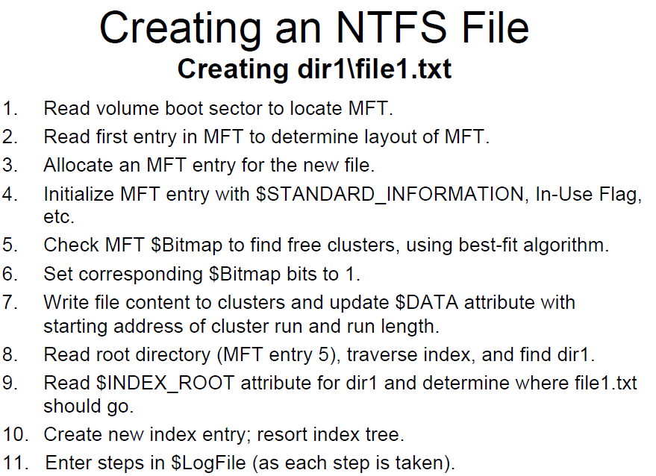

Slide 56
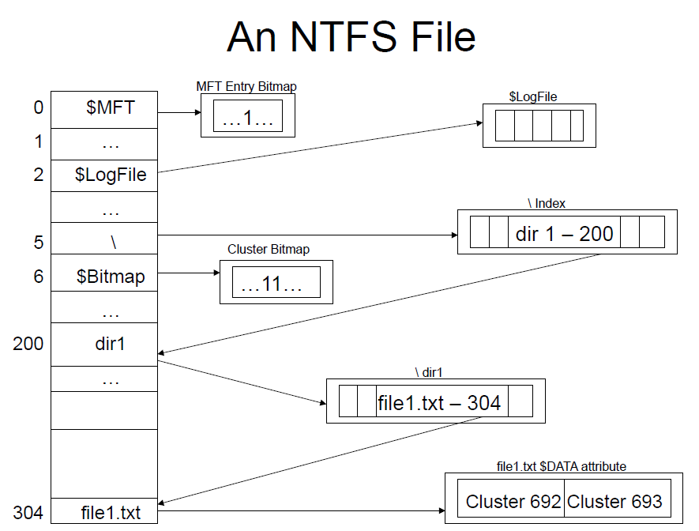

Slide 57
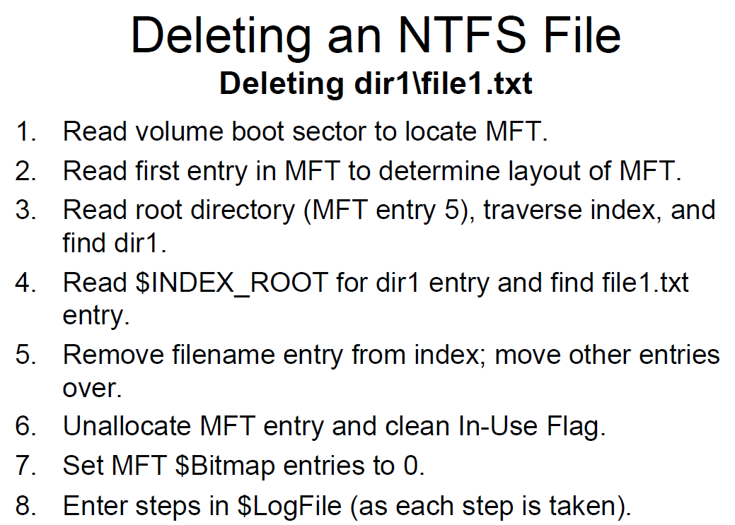

Slide 58
$logfile
If you are interested in research
http://forensicinsight.org/wp-content/uploads/2013/06/F-INSIGHT-NTFS-Log-TrackerEnglish.pdf

Slide 59
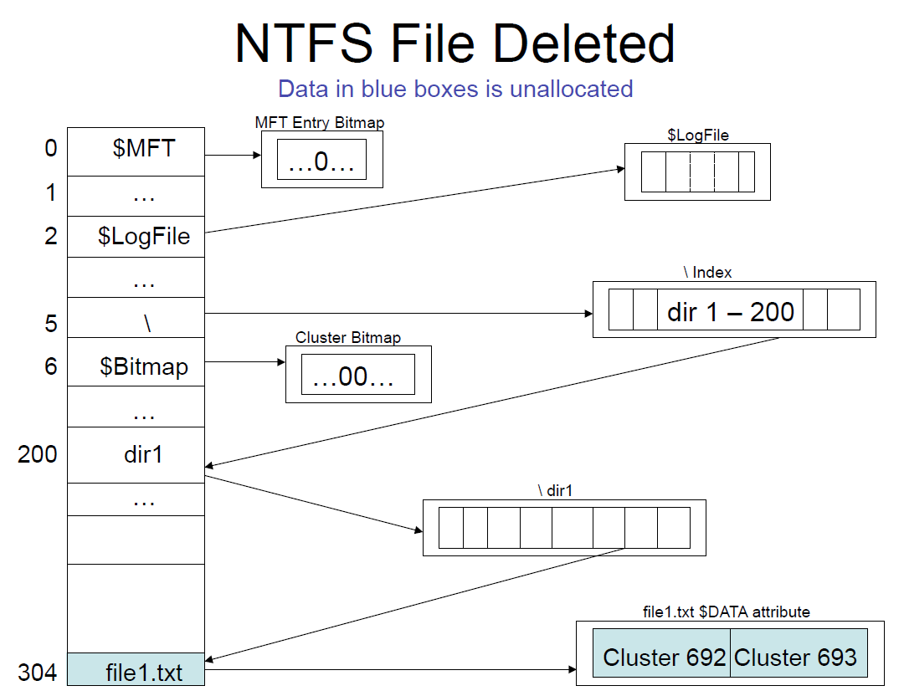

Slide 60
NTFS Example

Slide 61
NTFS Example
Use WinHex to go directly to the partition.
WinHex will read the boot sector and allow easier navigation.

Slide 62
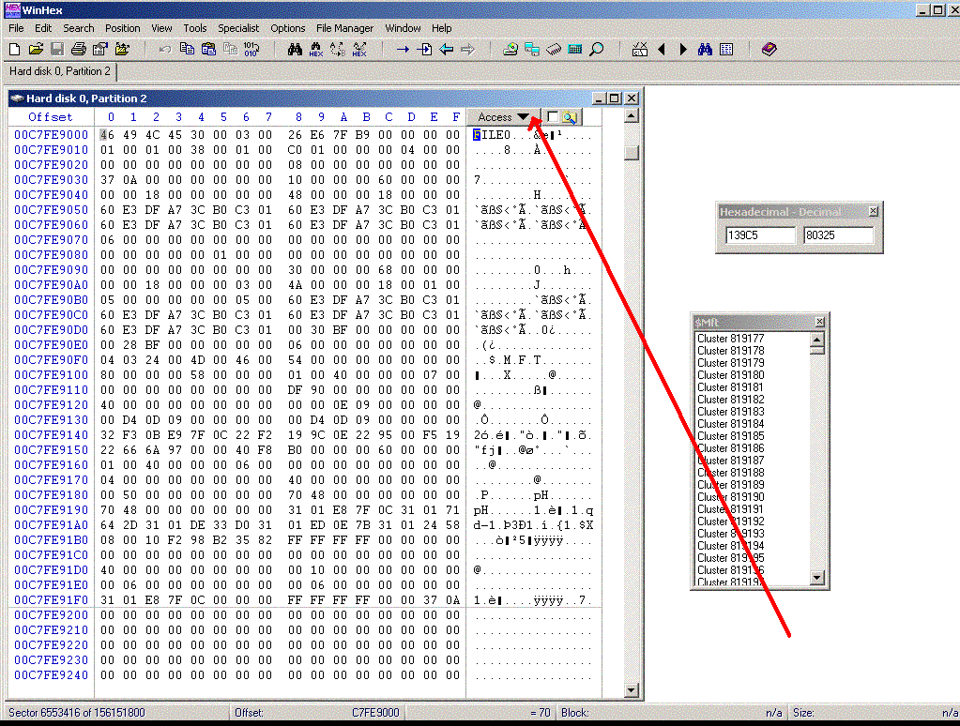

Slide 63
NTFS Example
Disassembling MFT entries by hand is difficult.
Use tools.
WinHex allows you to look at the file structure.

Slide 64
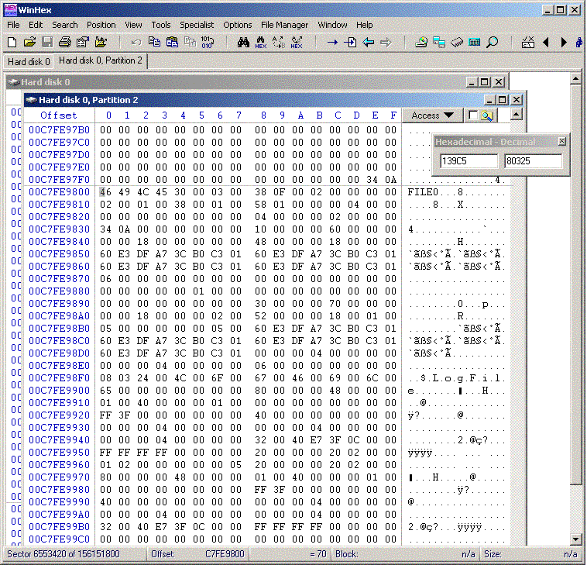

Slide 65
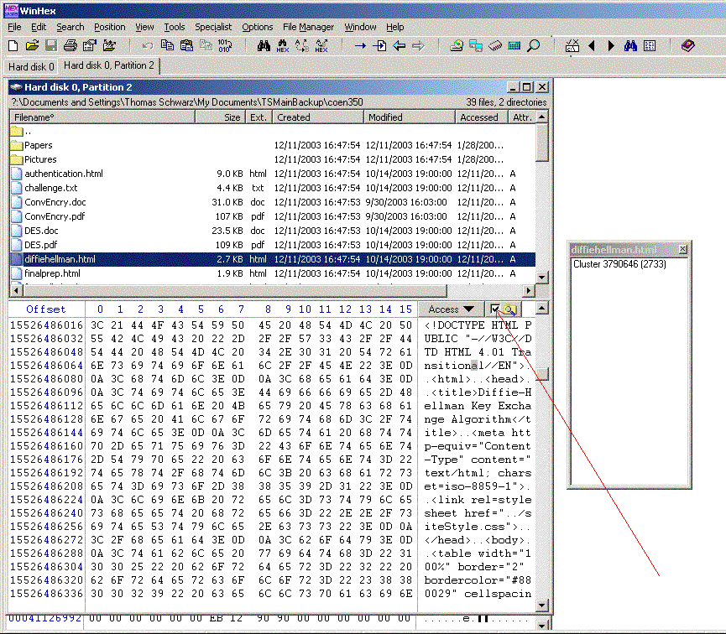

Slide 66
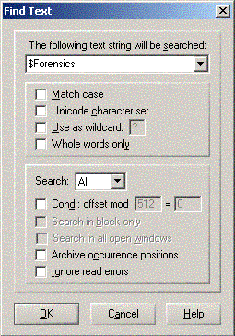
NTFS Example
WinHex allows to search for strings

Slide 67
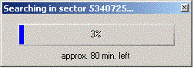
NTFS Example
But string searches can take a long time.

Slide 68
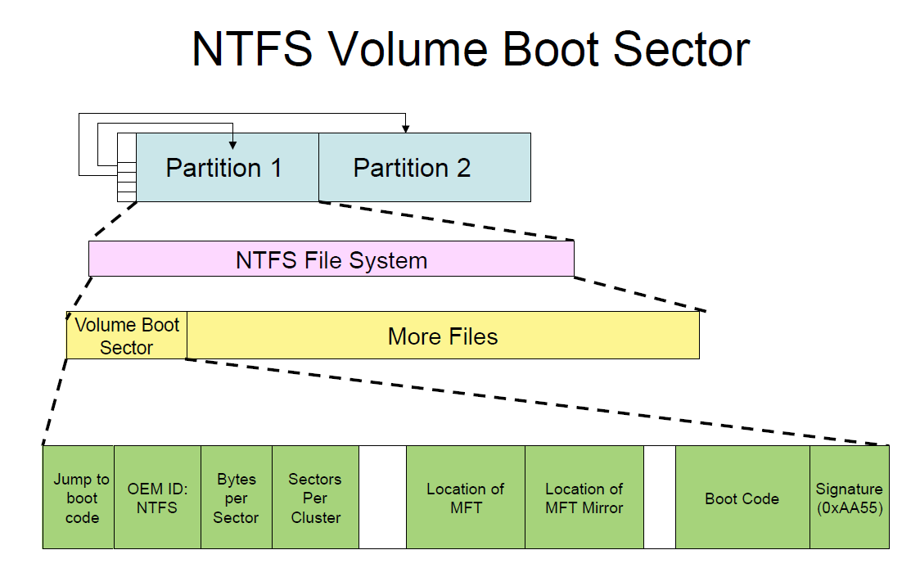
Summary

Slide 69
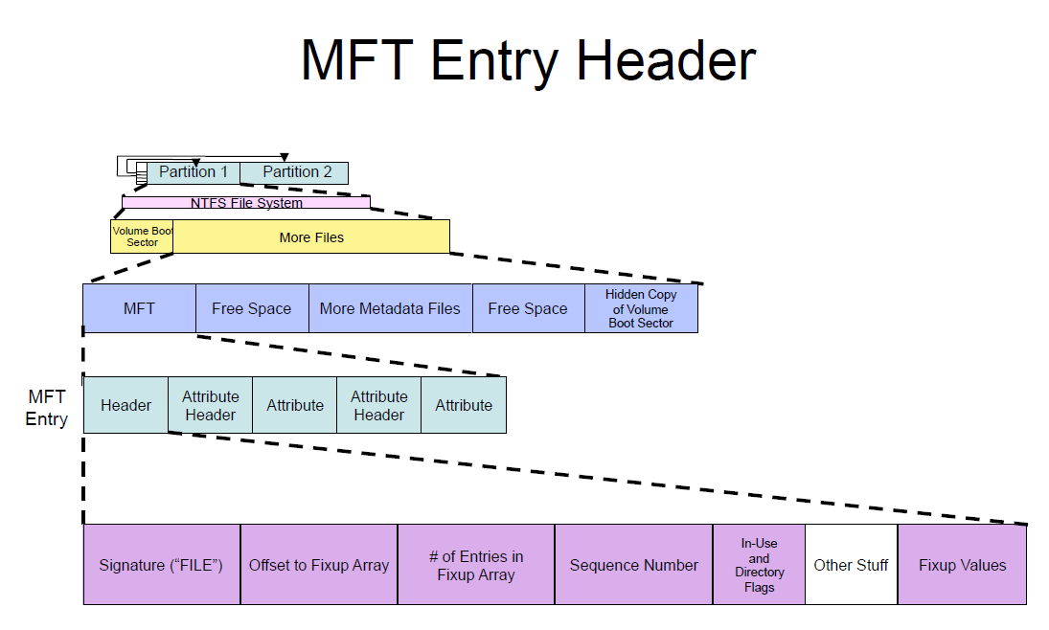

Slide 70
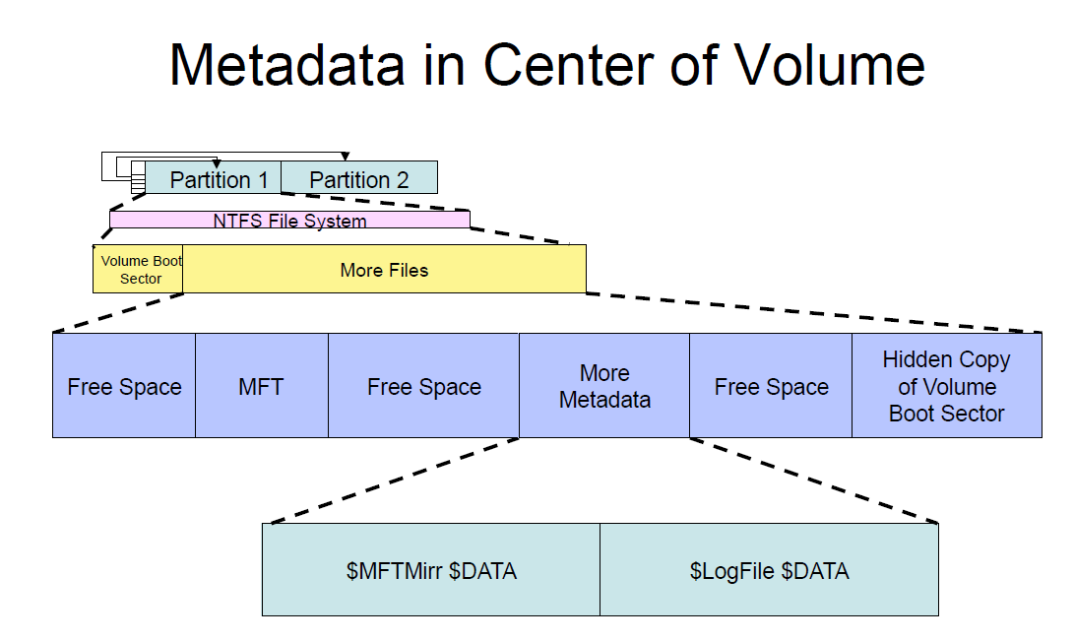

Slide 72
Reference
http://www.cse.scu.edu/~tschwarz/COEN252_09/Lectures/NTFS.html
https://www.youtube.com/watch?v=xW5UwDztkX4
https://docs.microsoft.com/en-us/windows-server/storage/disk-management/change-an-mbr-disk-into-a-gpt-disk
http://thestarman.pcministry.com/asm/mbr/NTFSBR.htm
http://www.kes.talktalk.net/ntfs/
http://amanda.secured.org/ntfs-mft-record-parsing-parser/
https://pdfs.semanticscholar.org/presentation/0209/570d0f395dd3da03d55ab5ea56214764269e.pdf

